Slide 1
Personal AI Knowledge Assistant using Retrieval-Augmented Generation (RAG)
Mini Project 5
Presented By
Anushka T
Weekday batch (AIML)

Slide 2
Introduction
Artificial Intelligence & RAG
Retrieval-Augmented Generation (RAG) combines information retrieval with Large Language Models.
It retrieves relevant information from external documents before generating responses.
This approach reduces hallucinations and improves answer accuracy

Slide 3
Problem Statement
Develop an intelligent AI-powered chatbot system that can process multiple documents (PDFs, text files) and allow users to ask questions in natural language. The system should retrieve relevant information from the documents and generate accurate, context-aware responses using a Large Language Model (LLM) and Retrieval-Augmented Generation (RAG).

Slide 4
Objectives
Develop an AI-powered assistant for document question answering.
Retrieve relevant information using FAISS and RAG.
Generate accurate, context-aware responses.
Improve document accessibility and reduce manual search time.

Slide 5
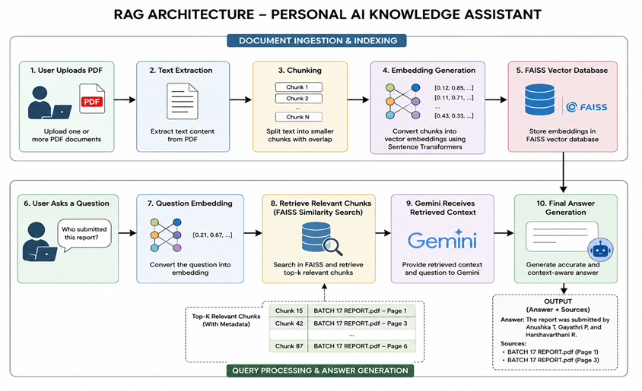
RAG Architecture

Slide 6
Technologies Used
Component | Technology
Frontend | Streamlit
PDF Processing | PyPDF
Chunking | LangChain Text Splitter
Embeddings | all-MiniLM-L6-v2
Vector Database | FAISS
LLM | Google Gemini
Environment Variables | python-dotenv

Slide 7
Algorithms/Models
Component | Type
Sentence Transformer | Deep Learning / Transformer-based NLP Model
FAISS | Vector Search and Indexing Algorithm
Cosine Similarity | Similarity Measurement Algorithm
Gemini | Large Language Model (LLM)
RAG | AI Architecture / Framework

Slide 8
Features Implemented
✅ Multiple PDF Upload
✅ Chat-based Interface
✅ Metadata Support
Source Document Name
Page Number
✅ Chat History

Slide 9
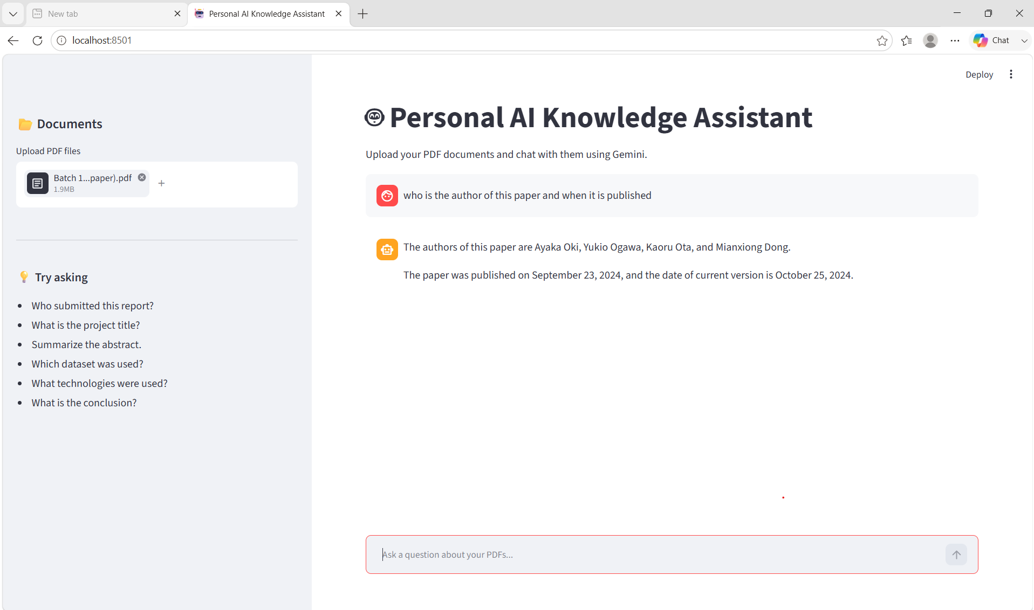
Results and Demonstration

Slide 10
Conclusion & Future Scope
Conclusion
A Personal AI Knowledge Assistant was successfully developed using RAG architecture. The system can retrieve information from uploaded PDFs and generate accurate, context-aware answers with source transparency.
Future Scope
Support DOCX and Excel files.
Voice-based interaction.
Local LLM integration.
Export chat responses.
Web search integration.

